Slide 1
Java 4 WEB
Lesson 9 – Stream API

Slide 2
Lesson goals
Remind lambdas
java.util.Stream
Remind java.util.Optional

Slide 3
Lambda overview
Anonymous class
Runnable r1 = new Runnable() {
@Override
public void run() {
System.out.print("Hello");
}
};
Lambda
Runnable r2 = () -> { System.out.print("Hello"); };

Slide 4

Lambda vs Anonymous class
@FunctionalInterface interface Translator { String translate(String input); }
public static void main(String[] args) { Translator oldSchool = new Translator() { @Override public String translate(String input) { return input.toLowerCase(); } }; Translator newSchool = input -> input.toLowerCase();
Translator newerSchool = String::toLowerCase; }

Slide 5
Common functional interfaces
Functional Interface | #Parameters | Return Type | Single Abstract Method
Supplier<T> | 0 | T | get
Consumer<T> | 1 | void | accept
Predicate<T> | 1 | boolean | test
Function<T, R> | 1 | R | apply

Slide 6
Supplier
@FunctionalInterface interface Supplier<T> { T get(); }
class Beer{ //... }
public static void main(String[] args) { Supplier<Beer> supplier1 = () -> new Beer(); Supplier<Beer> supplier2 = Beer::new;
Supplier<Beer> supplier3 = new Supplier<Beer>() {
…. println(supplier1.get()); // Beer@123ec81 println(supplier1.get()); // Beer@cbcfc0 println(supplier2.get()); // Beer@1184fc6 println(supplier2.get()); // Beer@1496d9f
println(supplier1); // Main$$Lambda$1/30852576@3279cf println(supplier2); // Main$$Lambda$1/30852576@3279cf }
Notes:
$$ - means that the class doesn’t exist in a class file on the file system

Slide 7
Consumer
@FunctionalInterface interface Consumer<T> { void accept(T t); }
class Beer{ //... }
public static void main(String[] args) { Supplier<Beer> supplier1 = () -> new Beer(); Supplier<Beer> supplier2 = Beer::new; Consumer<Beer> consumer1 = beer -> System.out.println(beer); Consumer<Beer> consumer2 = System.out::println; consumer1.accept(supplier1.get()); // Beer@14c966a consumer1.accept(supplier2.get()); // Beer@14d3709 consumer2.accept(supplier1.get()); // Beer@50df2e consumer2.accept(supplier2.get()); // Beer@181eb93 }

Slide 8
Predicate
@FunctionalInterface interface Predicate<T> { boolean test(T t); }
class Beer { //... boolean isTasty() { return false; } }
public static void main(String[] args) { Predicate<Beer> predicate1 = beer -> beer.isTasty(); Predicate<Beer> predicate2 = Beer::isTasty; Supplier<Beer> supplier = Beer::new;
println(predicate1.test(supplier.get())); // false
println(predicate2.test(supplier.get())); // false }

Slide 9
Function
@FunctionalInterface interface Function<T, R> { R apply(T t); }
class Water { //... }
class Wine { Wine(Water water) { // magic } }
public static void main(String[] args) { Function<Water, Wine> god1 = water -> new Wine(water); Function<Water, Wine> god2 = Wine::new; println(god1.apply(new Water())); // Wine@1eba861 println(god2.apply(new Water())); // Wine@1480cf9 }

Slide 10
Own interface
@FunctionalInterface interface QuadFunction<T, U, V, W, R> { R apply(T t, U u, V v, W w); } public static void main(String[] args) {
QuadFunction<Integer, Integer, Integer, Integer, Integer>
quadFunction = (a, b, c, d) -> a * b + c * d; System.out.print(quadFunction.apply(1, 2, 3, 4)); // 14 }

Slide 11
What to choose:
What functional interface would you use in these next situations?
Returns a String without taking any parameters
Returns a Boolean and takes a String
Returns an Integer and takes String
Returns nothing, takes Integer

Slide 12
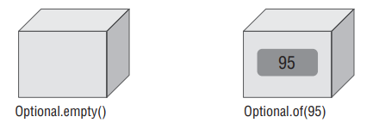
Optional
Optional - “we don’t know” or “not applicable”
created using a factory
a clear way to express that null might be a special value
Notes:
A container object which may or may not contain a non-null value. If a value is present, isPresent() will return true and get() will return the value.
Additional methods that depend on the presence or absence of a contained value are provided, such as orElse() (return a default value if value not present) and ifPresent() (execute a block of code if the value is present).

Slide 13
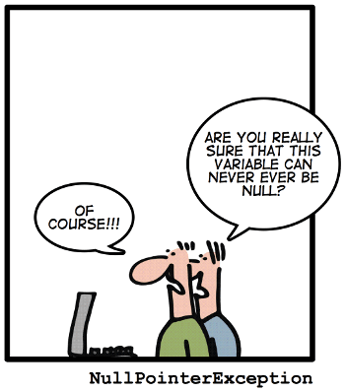
Optional creation
Optional.of(…)
Optional.ofNullable(…)
Optional.empty()
From stream terminal operation

Slide 14
Optional methods
T get(); boolean isPresent(); boolean isEmpty(); void ifPresent(Consumer<? super T> action); void ifPresentOrElse(Consumer<? super T> action, Runnable emptyAction); Optional<T> filter(Predicate<? super T> predicate); <U> Optional<U> map(Function<? super T, ? extends U> mapper); <U> Optional<U> flatMap(Function<? super T, ? extends Optional<? extends U>> mapper); Optional<T> or(Supplier<? extends Optional<? extends T>> supplier); Stream<T> stream(); T orElse(T other); T orElseGet(Supplier<? extends T> supplier); T orElseThrow(); <X extends Throwable> T orElseThrow(Supplier<? extends X> exceptionSupplier) throws X;

Slide 15
Stream
A stream in Java is a sequence of data
A stream pipeline is the operations that run on a stream to produce a result
Finite and Infinite
Lazy evaluated
Not reusable!

Slide 16

Stream parts
Source
Intermediate operations
Terminal operation

Slide 17
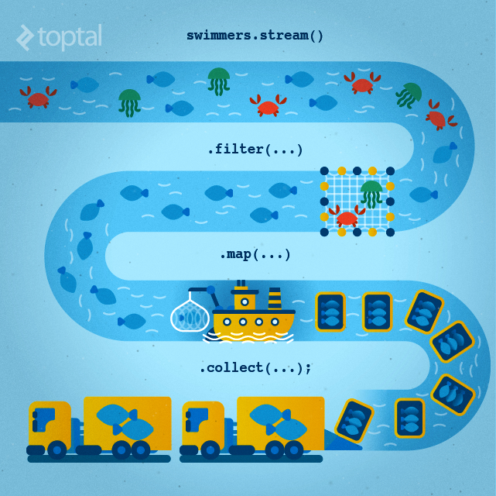
Stream parts

Slide 18
Stream parts example
Collection<String> collection = Arrays.asList("John","Simon","Julia","Robert");
List<String> result = collection.stream() // source
.filter(item -> item.startsWith("J")) // intermediate .map(item -> "Saint ".concat(item)) // intermediate .sorted((s1, s2) -> Integer.compare(s2.length(), s1.length())) // intermediate .collect(Collectors.toList()); // terminal
System.out.print(result); // [Saint Julia, Saint John]

Slide 19
Stream source
Stream<String> empty = Stream.empty(); // count = 0
Stream<Integer> singleElement = Stream.of(1,2); // count = 2
Integer[] ints = {1,2,3}; Stream<Integer> fromArray = Stream.of(ints); // count = 3
List<Integer> list = Arrays.asList(1, 2, 3, 4); Stream<Integer> fromList = list.stream(); // count = 4
Stream<String> fromListParallel = list.parallelStream(); // count = 4
Stream<Double> randoms = Stream.generate(Math::random);
Stream<Integer> oddNumbers = Stream.iterate(1, n -> n + 2).limit(10);

Slide 20
Stream intermediate operations
filter - return a new stream that contains elements that match its predicate.
map - transform the elements in a stream using the provided java.util.function.Function
flatMap - transform each element into zero or more elements by a way of another stream
peek - allows to peek into the stream before an action is encountered
distinct - find unique elements in a stream according to their .equals behavior.
sorted - return a stream sorted according to natural order (or passed comparator)
limit - limit the number or truncate elements to be processed in the stream
skip - skip the start elements to be processed in the stream

Slide 21
Stream intermediate operations
Supplier<Stream<Integer>> numbers = () -> Stream.of(5, 4, 1, 3); numbers.get().filter(num -> num > 3).collect(toList()); // [5, 4] numbers.get().map(num -> num * 2).collect(toList()); // [10, 8, 2, 6] numbers.get().limit(3).collect(toList()); // [5, 4, 1] numbers.get().sorted().collect(toList()); // [1, 3, 4, 5] numbers.get().distinct().collect(toList()); // [5, 4, 1, 3]
numbers.get().peek(System.out::println).collect(toList()); // [5, 4, 1, 3]
numbers.get().skip(2).collect(toList()); // [1, 3]

Slide 22
Stream terminal operations
allMatch() - check every element in the stream and find out if it matches the predicate
anyMatch() - find out whether at least one of the elements in the stream matches a given predicate.
noneMatch() - find if no elements in the stream match the specified predicate
collect() - convert the stream into some other container such as a list.
count() - find the number of elements in the stream
findAny() - find any element in a given stream.
findFirst() - find the first element in the stream
forEach() - perform an action for each element in the stream
min()/max() - find the minimum or maximum of a stream
reduce() - combine the stream elements into one using a BinaryOperator

Slide 23
Stream terminal operations
Supplier<Stream<Integer>> numbers = () -> Stream.of(5, 4, 1, 3); numbers.get().count(); // 4 numbers.get().max(comparingInt(n -> n)); // Optional[5] numbers.get().findAny(); // Optional[5] numbers.get().findFirst(); // Optional[5] numbers.get().allMatch(n -> n > 0); // true numbers.get().forEach(System.out::println); // 5 4 1 3 numbers.get().reduce(0, (n1, n2) -> n1 + n2)); // Optional[13] numbers.get().map(n -> n * n).collect(toList()); // [25, 16, 1, 9]

Slide 24
Stream order and parallel
Encounter order - the order in which the stream source makes it's elements available
Supplier<Stream<Integer>> s = () -> Stream.iterate(1, i -> i + 1).limit(10); s.get().forEach(System.out::print); // 12345678910 s.get().unordered().forEach(System.out::print); // 12345678910 s.get().parallel().forEach(System.out::print); // 78641032195 s.get().parallel().unordered().forEach(System.out::print); // 78109124365

Slide 25
Stream collectors
<R, A> R collect(Collector<? super T, A, R> collector)
<R> R collect(Supplier<R> supplier, BiConsumer<R, ? super T> accumulator, BiConsumer<R,R> combiner)
Supplier<Stream<Character>> stream = () ->
Stream.of('w', 'o', 'l', 'f', '1', '3') .filter(Character::isLetter) .map(Character::toUpperCase);
stream.get()
.collect(Collectors.toList())); // [W, O, L, F] stream.get()
.collect(StringBuilder::new, StringBuilder::append, StringBuilder::append)); // WOLF

Slide 26
Stream, working with primitives
IntStream: Used for the primitive types int, short, byte, and char
LongStream: Used for the primitive type long
DoubleStream: Used for the primitive types double and float

Slide 27
Stream, working with primitives
OptionalDouble averageInteger = Stream.of(1.1, 2.6, 3.8) .mapToInt(Double::intValue) .average(); averageInteger.getAsDouble(); // 2.0
OptionalDouble averageInt = IntStream.of(1, 2, 3) .average();
averageInt.getAsDouble(); // 2.0

Slide 28
Primitives stream, statistic
IntSummaryStatistics intSummaryStatistics = Stream.of(1, 2, 3) .mapToInt(integer -> integer) .summaryStatistics(); intSummaryStatistics.getMax(); // 3 intSummaryStatistics.getMin(); // 1 intSummaryStatistics.getSum(); // 6 intSummaryStatistics.getAverage(); // 2.0 intSummaryStatistics.getCount(); // 3

Slide 29
Literature
Stream package summary
Streams cheat sheet
Habr luxoft
Baeldung collectors
Optional
IBM Blog
Chapter 1/5
Chapter 2/5
Chapter 3/5
Chapter 4/5
Chapter 5/5

Slide 30
Homework Task 1
Implement all methods from interface CollectionOperations according to Java docs that describe each method. Implement using only java Stream API (no manual processing)
Implement unit tests for every method

Slide 31
public interface CollectionOperations { <E> List<E> fill(Supplier<E> producer, int count); <E> List<E> filter(List<E> elements, Predicate<E> filter); <E> boolean anyMatch(List<E> elements, Predicate<E> predicate); <E> boolean allMatch(List<E> elements, Predicate<E> predicate); <E> boolean noneMatch(List<E> elements, Predicate<E> predicate); <T, R> List<R> map(List<T> elements, Function<T, R> mappingFunction); <E> Optional<E> max(List<E> elements, Comparator<E> comparator); <E> Optional<E> min(List<E> elements, Comparator<E> comparator); <E> List<E> distinct(List<E> elements); <E> void forEach(List<E> elements, Consumer<E> consumer); <E> Optional<E> reduce(List<E> elements, BinaryOperator<E> accumulator); <E> E reduce(E seed, List<E> elements, BinaryOperator<E> accumulator); <E> Map<Boolean, List<E>> partitionBy(List<E> elements, Predicate<E> predicate); <T, K> Map<K, List<T>> groupBy(List<T> elements, Function<T, K> classifier); <T, K, U> Map<K, U> toMap(
List<T> elements,
Function<T, K> keyFunction,
Function<T, U> valueFunction,
BinaryOperator<U> mergeFunction
); }

Slide 32
Q&A

